Slide 1

Project 1- Amazon Sales Data Analysis

Slide 2
Introduction
Amazon generates vast amounts of sales data, capturing customer behavior, product trends, and market performance across its platform.
Analyzing sales data helps identify patterns, optimize marketing strategies, forecast demand, and improve business decisions.
The goal is to uncover insights from Amazon sales data, focusing on sales trends, product performance, and customer preferences.
Effective analysis can drive profitability, refine inventory management, and enhance customer satisfaction, leading to sustained growth.

Slide 3
Key Findings
Total profit and revenue breakdown by month
Sales by item type and order priority
Sales by item type and sum of units sold
Sales by item type and sum of total profit

Slide 4
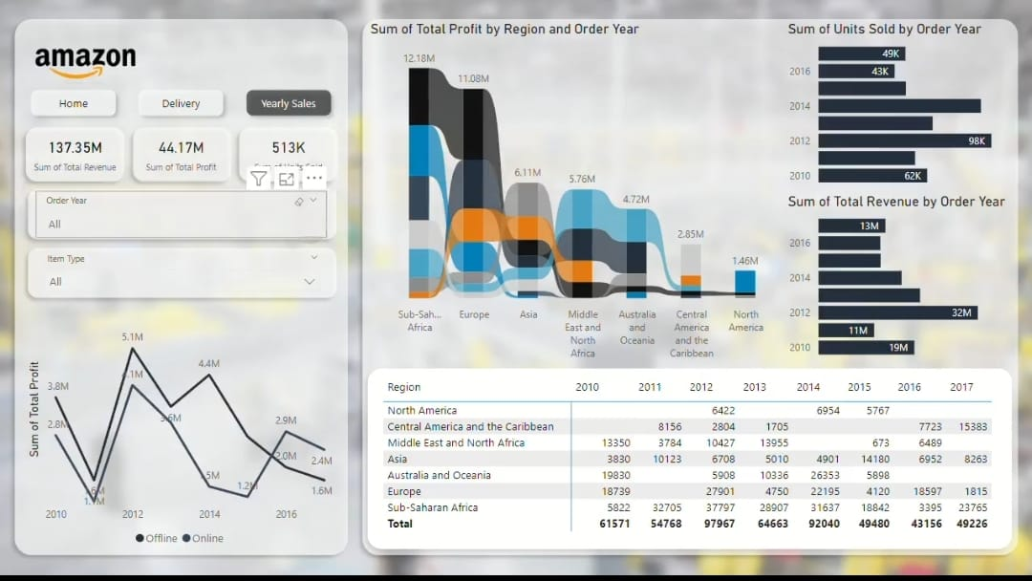
MY DESIGN
Video Link : https://drive.google.com/file/d/12O0Zjq7qF8pUIa4C1tJkPBxX-rOoEME2/view?usp=drivesdk

Slide 5

Project 2- EMPLOYEE ATRITION ANALYSIS

Slide 6
Introduction
Employee attrition refers to the gradual reduction of staff due to resignations, retirements, or other factors without immediate replacement.
High attrition rates can lead to increased recruitment and training costs, loss of institutional knowledge, and decreased employee morale.
The analysis aims to identify key factors contributing to employee attrition and provide actionable insights to improve retention.
Leveraging data analytics helps organizations to better understand attrition patterns and develop effective strategies to retain talent.

Slide 7
Key Findings
Attrition Rate by Department, Gender, and Age
Attrition by Job Role and Education Field
Years in Company vs. Attrition Rate
Detailed insights into Job Role Performance

Slide 8
Details of Data
📊 Total Employees: 4300
📊 Overall Attrition Rate: 16.2%
📊 Number of Attritions: 695

Slide 9
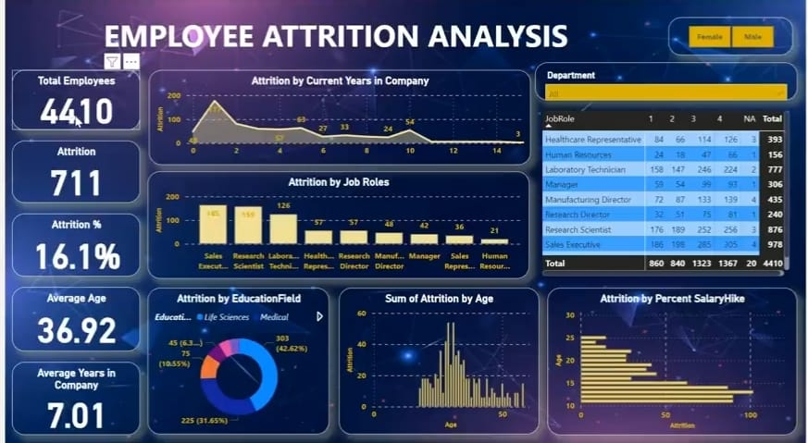
My design
Videolink : https://drive.google.com/file/d/12EDOOUNXF8CLVpaIOwJCy6JXkr2HmnBd/view?usp=drivesdk

Slide 10

Project 3- Entertainer Data Analytics

Slide 11
INTRODUCTION
Entertainer Data Analytics involves the collection, analysis, and interpretation of data related to entertainers, their audiences, and the entertainment industry.
Data analytics helps entertainers and industry professionals make informed decisions about content creation, marketing, and audience engagement strategies.
Metrics such as audience demographics, engagement rates, revenue streams, and performance trends are critical in shaping an entertainer's career.
By leveraging data, entertainers can optimize their content, increase audience satisfaction, and improve their overall market impact.

Slide 12
Key Findings
Year of First Major Awards
Year of breakthrough Analysis
Heatmap Analysis – Relationship between breakthrough and first major award
Statistcal Analysis of breakthrough and first major award

Slide 13
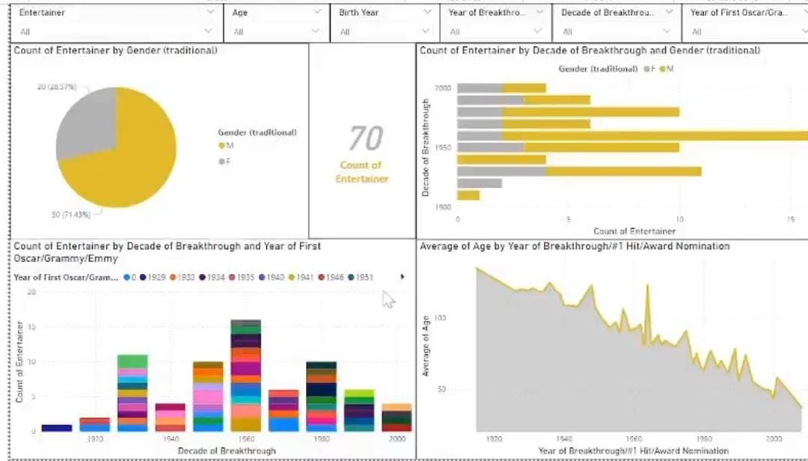
My Design
Video Link https://drive.google.com/file/d/12MM7GNGtj8MtlC0E0p5pdT3UUHITktP0/view?usp=drivesdk

Slide 14

Project 4 - FIFA World Cup Analysis

Slide 15
INTRODUCTION
The FIFA World Cup is the most prestigious international football tournament, held every four years, featuring teams from across the globe.
Since its inception in 1930, the World Cup has evolved into a major sporting event, uniting nations and showcasing the best football talent.
This analysis explores key data trends, performance metrics, and patterns across multiple World Cups to derive meaningful insights.
The goal is to uncover statistical trends and identify factors that contribute to the success of teams in the FIFA World Cup.

Slide 16
Key Findings
Dynamic Match Analysis: Dive deep into match statistics, from goals scored to possession percentages, offering a comprehensive view of each game's dynamics.
Team Performance Metrics: Track the performance of your favorite teams with intuitive visuals showcasing goals, assists, and more, providing invaluable insights into their strategies and strengths.
Winners and Audience Presence: Discover insights into the cities where matches took place, along with audience presence in stadiums, providing a holistic view of the tournament's reach and impact.

Slide 17
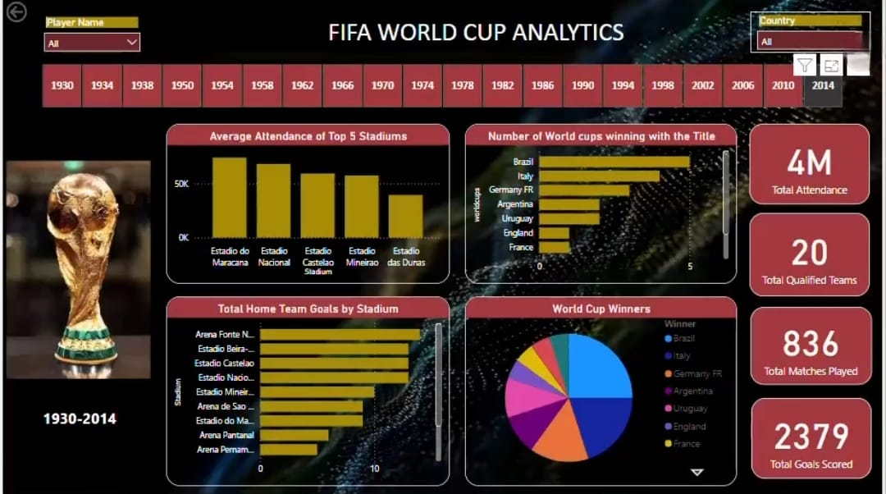
My Design
Video Link
https://drive.google.com/file/d/12Er4coopRMokGViDl3JInW7XXU3QfvV1/view?usp=drivesdk

Slide 18
Thank You
Vignesh Kamalakannan
UMIP15714

